Slide 1

DUAL SERVER PUBLIC KEY ENCRYPTION FOR SECURE CLOUD STORAGE WITH KEYWORD SEARCH
SUBMITTED BY
DEVIDAS KINI M 4CB16CS024
K VIGNESH KAMATH 4CB16CS030
KARTIKEYA K PAI 4CB16CS032
KARTIKEY U SHET 4CB16CS033

Slide 2

ABSTRACT
Nowadays cloud computing has become one of the fascinating domains which was used by almost all MNC and IT companies.
Generally, this is formed by interconnecting a large number of systems hosted on internet.
Lot of users can connect with the centralized location to access, retrieve and modify the data which is stored on the cloud server.
Here RSA algorithm is used to encrypt the file and upload it onto the cloud server by appending unique keyword to it.
A secure channel between data owner and client is created using deffie-helmann key exchange algorithm.
This channel is used to share the keyword.
Binary searching technique is implemented to search the file using the keyword in the cloud server.

Slide 3
TABLE OF CONTENTS
CONTENT | PAGE NUMBER
ABSTRACT | i
1.INTRODUCTION | 1
1.1 OBJECTIVE | 3
1.2 OUTCOME | 3
1.3 SCOPE | 3
2. LITERATURE SURVEY | 4
3. METHODOLOGY | 14
3.1 ARCHITECTURE 3.2 ALGORITHM | 14 16
REFERENCE | 19

Slide 4
LIST OF FIGURES
FIGURE | PAGE NUMBER
FIGURE 3.1.1. ARCHITECTURE | 14
FIGURE 3.1.2 GANTT CHART | 18

Slide 5
1.INTRODUCTION
Cloud storage outsourcing has become a popular application for enterprises and organizations to reduce the burden of maintaining big data in recent years.
However, in reality, end users may not entirely trust the cloud storage servers and may prefer to encrypt their data before uploading them to the cloud server in order to protect the data privacy.
Solutions here is searchable encryption which allows the user to retrieve the encrypted documents. Searchable encryption can be realized in either symmetric or asymmetric encryption setting.
In [2], Chen et al. proposed “Dual-Server Public-Key Encryption with Keyword Search for Secure Cloud Storage”. This provides well-known cryptographic primitive, namely Public Key Encryption which is very useful in many applications of cloud storage.
To overcome security vulnerability, a new framework named Dual-Server Public Key Encryption with Keyword Search is built which can prevent inherent security launched by the malicious server.

Slide 6
Users have to securely share keywords which are used for searching particular file. Otherwise they are not able to share the encrypted data outsourced to the cloud.
In a dual server system, using the receiver’s public key, a secure channel is established the sender attaches encrypted keywords (referred to as PEKS ciphertexts) with the encrypted data.
The back server then allows file to-be-searched with the help of keyword.

Slide 7
1.1 OBJECTIVE
Provides security to the user data.
Encrypted data is stored in cloud, appended with unique keyword for more security.
1.2 OUTCOME
Only Authorized user can access the data.
Easy access to the file based on the keyword search.
Provides more security and robustness.
1.3 SCOPE
By the concept of Dual Server Technology data can be stored in cloud in more secure way.
Data can be retrieved with more ease and less error.

Slide 8
2.LITERATURE SURVEY
Lei Xu [1] et al., proposed “Efficient and Secure Data Retrieval Scheme Using Searchable Encryption in Cloud Storage” which represents a data retrieval system by using public key encryption system with keyword search, in which the client could test whether or not the file stored in cloud server contains the keyword without leaking the information about the encrypted file. It also describes efficiency and point out that the verification algorithm just needs one pairing operation. The searchable encryption is based on recently, identity-based encryption system.
Gap Inferred: An efficient data retrieval system via asymmetric pairing in the standard model and security to the data is done using dual system technique. Searchable encryption based on identity.

Slide 9
Rongmao Chen [2] et al., proposed “Dual-Server Public-Key Encryption with Keyword Search for Secure Cloud Storage”. This provides well-known cryptographic primitive, namely Public Key Encryption with Keyword Search (PEKS) which is very useful in many applications of cloud storage. Unfortunately, it has been shown that the traditional PEKS framework suffers from an inherent insecurity called inside keyword Guessing Attack (KGA) launched by the malicious server. To overcome this security vulnerability, a new PEKS framework named Dual-Server Public Key Encryption with Keyword Search (DS-PEKS) is built which can prevent inside keyword guessing attack.
Gap Inferred: New framework is implemented, named Dual-Server Public-Key Encryption with Keyword Search which prevents inherent attacks.

Slide 10
Kaibin Huang [3] et.al., proposed “Provable Secure Dual-Server Public Key Encryption with Keyword Search” which introduced dual-server PEKS (DS-PEKS) syntax to deal with inner Keyword guessing attack issue. There are a front server and a back server in this architecture and the keyword search test is done by the co-operation of two servers. However, several flaws occur here so that the secrecy of index and trapdoors are not well-protected even against outside adversaries. So, a new DS-PEKS construction based on the Cramer Shoup encryption was introduced, whose index and trapdoors are provably indistinguishable against chosen keyword attacks.
Gap Inferred: No security for data exists in this framework so public key encryption was designed.

Slide 11
R. ChinnaSwamy [4] et al., proposed “An Efficient Semantic Secure Keyword Based Search Scheme in Cloud Storage Services” which proposes an efficient semantic secure keyword based search (ESSKS) scheme, which retrieves exact information needed by the user, ensuring that the same keyword does not always produce the same result, in user querying, reducing computational and communication overhead. This security mechanism also addresses the data integrity problem. It embargos the unauthorized users through the cipher text developed during the searching of data. It also provides solution to the data integrity problem raised during data transfer from cloud to the user and vice versa.
Gap Inferred: In this, a new privacy based search scheme was introduced which reduces time consumed in the searching of data.

Slide 12
Neelam S. Khan [5] et al., proposed “Secure Ranked Fuzzy Multi-Keyword Search over Outsourced Encrypted Cloud Data” which formulize and solve the problem of effective Secure Ranked Fuzzy Multi-Keyword Search over Outsourced Encrypted Cloud Data (RFMS). Information discovery has been made efficient by searching with multiple keywords with ranking so as to eliminate false positives. Keyword dictionary has been made dynamic. Overhead of updating the dictionary when new files need to be uploaded has been minimized. Also, by using one-to-many mapping between plaintext and cipher text, the method guarantees security. Here an attempt was made to improve the data discovery and user searching experience by supporting Secure Ranked Fuzzy Multi Keyword Search.
Gap Inferred: Data discovery and user searching experience was improved by Ranked Fuzzy Multi-Keyword Search. Here time to generate the index was reduced.

Slide 13
Yilun Wu [6] et al., proposed “Keyword Search over Shared Cloud Data without Secure Channel or Authority” which propose a novel mechanism that supports multi-user keyword search over the encrypted data without relying on any secure channel or authority. The eavesdropper can neither forge valid trapdoors from the intercepted information nor can it directly use the intercepted trapdoors to complete the keyword search. This mechanism provides secure keyword search over encrypted data even in the presence of a stronger adversary who can eavesdrop on all transmission channels. This mechanism does not require any authentication authority for access control. While all users can perform search in the mechanism, only those authorized users will get correct results.
Gap Inferred: A keyword search mechanism with multi user setting under more complex scenario where no secure transmission channel existed between data owner and data user.

Slide 14
Qiongyu Zhang [7] et.al., proposed “Cloud Storage Oriented Secure Information Gateway”. This enables one to search for the encrypted keywords without leaking the privacy. This points out the inefficiency of SCF-PEKS scheme and construct a new Located Secure Channel Free Public Key Encryption with Keyword Search (LSCF-PEKS) scheme to improve the efficiency. Furthermore, the LSCF-PEKS scheme is applied to implement cloud storage-oriented secure information gateway. This scheme is more efficient and practical than SCF-PEKS when faced with mass data. And a bidding system can be implemented as a case to describe how to interact with the gateway.
Gap Inferred: A efficient Public Encryption keyword standard scheme was proposed, where a cloud storage
information gateway was constructed.

Slide 15
Dongsheng Wang [8] et al., proposed “A Privacy-preserving Fuzzy Keyword Search Scheme over Encrypted Cloud Data” which introduced F2SE which is a novel fuzzy keyword search scheme over encrypted cloud data which uses a keyword fingerprint extraction and secure kNN encryption which is upgraded version of sFKS scheme. It can also return keywords with special substrings used by the cloud users. The practicality and efficiency of this scheme is low memory cost and high searching accuracy.
Gap Inferred: A practical fuzzy keyword search scheme over encrypted cloud data was designed.

Slide 16
P.Pandiaraja [9] et al., proposed “Efficient Multikeyword Search Over Encrypted Data in Untrusted Cloud Environment” which introduced a scheme to deal with preserving the privacy in the cloud using multi-keyword search and to enable the cloud to perform secure accessing of data without the knowledge of real data. This scheme provides permission for keyword searches in cloud without revealing the privacy of the users. This also provides a method to implement Apriori algorithm based on secure computation which reduces computational time to access file in the cloud.
Gap Inferred: Privacy of data was protected using authorization for keyword searches and apriori algorithm was Implemented for secure computation of inner product.

Slide 17
Xinrui Ge [10] proposed “Enabling Efficient Verifiable Fuzzy Keyword Search over Encrypted Data in Cloud Computing” which introduced verifiable exact keyword search scheme and was extended to novel verifiable fuzzy keyword search scheme over encrypted cloud data to address the issue. This scheme uses linked-list for secure index to achieve efficient storage. Here linked list with three nodes is constructed and a fuzzy keyword is generated and a index vector is created for each fuzzy keyword set to reduce the computational cost and storage space. An authentication label is provided for each fuzzy keyword to verify the authenticity of returned cipher texts.
Gap Inferred: A new framework was designed named verifiable exact keyword server over encrypted cloud data and fuzzy keyword search was designed based on VEKS.

Slide 18
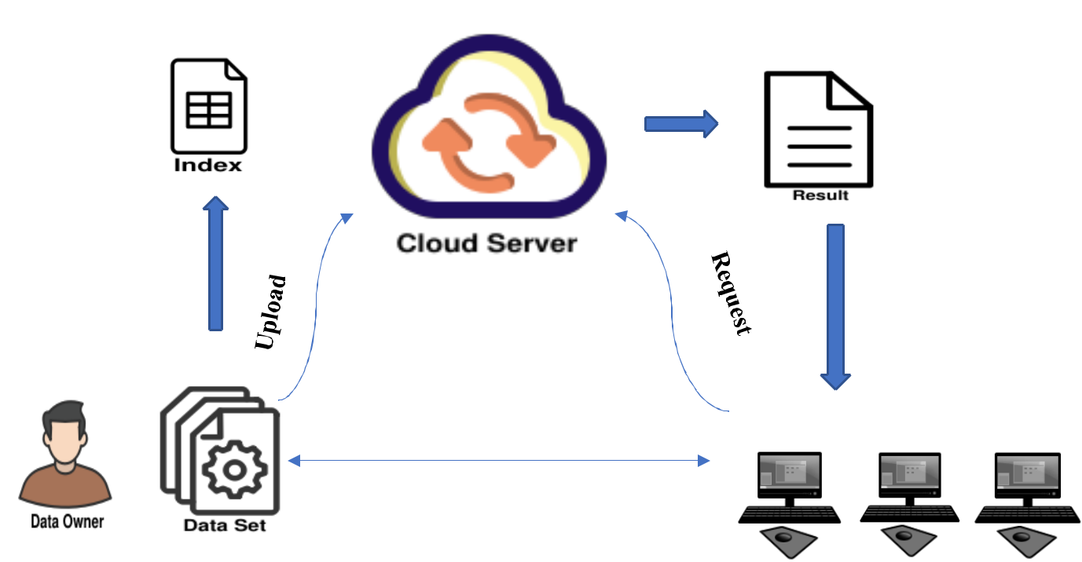
3.METHODOLOGIES
3.1 ARCHITECTURE
Fig 3.1.1: Dual server architecture

Slide 19
There are three main modules:
1.Data Owner:
Register with cloud server and login (username must be unique). Data owner encrypts his data using RSA algorithm and appends it with a unique keyword.
The data and the appended keyword is stored on the cloud server. In cloud server the data files are stored in sorted order of their respective keyword.
2.Data User:
Register with cloud server and login (username must be unique). User who wants particular data file will establish secure channel with the data owner using deffie helmann key exchange algorithm.
Using this channel keywords are shared. User searches for specific keyword and if he wants that data file, its owner will be notified.
Data owner based on the public key of the user will allow to access if he is a authorized person and the data is decrypted with the help of private key of owner and sent.
3.Dual Server:
Front server is used to upload the file with keyword and the back server will send the result to the queried user based on keyword.

Slide 20
3.2 ALGORITHM
Dual Server Setting:
Prepare the application tier server that satisfies the system requirements for Azure DevOps.
Prepare data tier server that meets the hardware recommendation.
Configure the firewall on data tier.
Public Key Encryption
2.1. Encryption at sender side:
Obtain the recipients public key (n, e).
Represents the plaintext message as a positive integer m with 1<m<n.
Computes the cipher text c=m^{e} mod n.
Sends the cipher text to recipient
2.2. Decryption at recipient side
Uses his private key (n, d) to compute m=c^{d} mod n.
Extracts the plaintext from the message representative m.

Slide 21
3. Deffie Helmann (for keyword request):
The key generator works as follows:
Select two numbers:- 1. prime number: p 2. r is an integer.
Suppose user A and B wish to exchange a key
User A select a random integer XA < p and computes YA = r XA mod p.
User B select a random integer XB < p and computes YB = r XB mod p.
Both sides keep the X value private and makes the Y value available publicly to the other side.
User A computes the key as K=(YB)XA mod p.
User B computes the key as K=(YA)XB mod p.
4.Binary Search:
Set low to 0 and high to n-1.
If low > high, the search terminates as unsuccessful.
Set mid to floor of (L+R)/2 which is greatest integer less than or equal to (L+R)/2.
If arr[mid] < key, set low to mid+1 and go to step 2.
If arr[mid] > key, set high to mid-1 and go to step 2.
Now arr[mid]=key, search is done return index i.e mid.

Slide 22
GANTT CHART
Fig 3.1.2: Dual server architecture

Slide 23
REFERENCES
[1] Lei Xu, Chungen Xu “Efficient and Secure Data Retrieval Scheme Using Searchable Encryption in Cloud Storage”, International Symposium on Security and Privacy in Social Networks and Big Data 2015,pp 15-21.
[2] Rongmao Chen, Yi Mu, Guomin Yang, Fuchun Guo, Xiaofen Wang “Dual-Server Public-Key Encryption with Keyword Search for Secure Cloud Storage”, IEEE Transactions on Information Forensics and Security, Volume: 11 , Issue: 4 , April 2016,pp 789-798.
[3] Kaibin Huang, Raylin Tso “Provable Secure Dual-Server Public Key Encryption with Keyword Search” IEEE Transactions on Information Forensics and Security 2017, pp 39-44.
[4] R. ChinnaSwamy, Dr. S. Sujatha “An Efficient Semantic Secure Keyword Based Search Scheme in Cloud Storage Services”, International Conference on Recent Trends in Information Technology 2012,pp 488-491.
[5] Neelam S. Khan, Dr. C. Rama Krishna “Secure Ranked Fuzzy Multi-Keyword Search over Outsourced Encrypted Cloud Data”- 5th International Conference on Computer and Communication Technology 2014,pp 241-249.
[6] Yilun Wu, Jinshu Su, Baochun Li “Keyword Search over Shared Cloud Data without Secure Channel or Authority”- IEEE 8th International Conference on Cloud Computing 2015,pp 580-587.

Slide 24
[7] Qiongyu Zhang, proposed “Cloud Storage Oriented Secure Information Gateway”, International Conference on Cloud Computing and Service Computing 2012,pp 119-123.
[8] Dongsheng Wang, proposed “A Privacy-preserving Fuzzy Keyword Search Scheme over Encrypted Cloud Data”, International Conference on Cloud Computing Technology and Science 2013,pp 663-670.
[9] P.Pandiaraja, proposed “Efficient Multikeyword Search Over Encrypted Data in Untrusted Cloud Environment”, 2nd International Conference on Recent Trends and Challenges in Computational Models 2017,pp 251-256.
[10] Xinrui Ge, proposed “Enabling Efficient Verifiable Fuzzy Keyword Search over Encrypted Data in Cloud Computing”, IEEE Access Volume 6, 2018, pp 45725-45739.

